Slide 1


Title: Vision Based Malware Classification Framework Based On Neural Network
RajshahI University of Engineering & Technology
Department of Computer Science & Engineering
Supervised By
Prof. Dr. Md. Ali Hossain
Professor
Dept. Of CSE, RUET
Presented By
Shah Ahmed Saad Rupai
Roll No.: 1703069
Dept. Of CSE, RUET
19.08.2023

Slide 2
Table of contents
01
Introduction
06
Proposed Method & Workflow
02
Motivation
07
Implementation
08
Result Analysis
03
Objectives
09
Model Comparison
04
Literature Review
10
Future Work
05
Dataset
11
Conclusion
12
Reference
02
19.08.2023

Slide 3
Introduction
Malware, or malicious software, refers to any type of program or code designed to harm computer systems or steal data.
There are a varieties of malwares present today , some of which are - Zeus, My-doom, Storm-worm, Slammer etc.
Different approaches have been used to detect & classify malwares. But malwares have emerged in such an extraordinary way that the traditional approaches are now not very effective.
03
19.08.2023
Vision Based Malware Classification Framework Based on Neural Network

Slide 4
Motivation
Traditional signature-based methods are less effective
A vision-based malware classification framework will work well
Neural Network has emerged as a promising solution
04
19.08.2023
Vision Based Malware Classification Framework Based on Neural Network

Slide 5
Objectives
01
02
03
develop a vision-based approach
develop optimized model
explore and evaluate models
05
19.08.2023
Vision Based Malware Classification Framework Based on Neural Network

Slide 6
Literature review
Paper Title & Author | Dataset & Models Used | Accuracy
Malware Images: Visualization and Automatic Classification. [1] L. Nataraj (2011) | Malware binaries are visualized as gray-scale images Classified using standard image features (PCA) and knn model by 10 fold cross validation using k=3 | Accuracy - 98%
Using convolutional neural networks for classification of malware represented as images. [2] Daniel Gibert (2018) | Malimg dataset & Microsoft Big dataset Convolution neural network(CNN) is used to classify | Accuracy: Malimg dataset - 96% & Microsoft Big dataset - 97.3%
Towards Building an Intelligent Anti-Malware System: A Deep Learning Approach using Support Vector Machine (SVM) for Malware Classification.[3] Abien Fred M. Agarap (2019) | Malimg dataset CNN-SVM, GRU-SVM, and MLP-SVM models used for classification | Accuracy: 84.92%
06
19.08.2023
Vision Based Malware Classification Framework Based on Neural Network

Slide 7
Dataset Description
The deep learning (DL) model in this study will be evaluated on the Malimg dataset[4],
The dataset contains 9,339 malware samples
These malware samples are from 25 different malware families
07
19.08.2023
Vision Based Malware Classification Framework Based on Neural Network

Slide 8
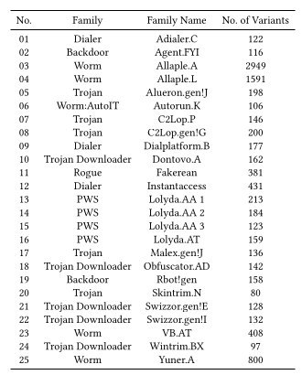
Dataset Description Cont.
Table 1 shows the frequency distribution of malware families and their variants in the Malimg dataset[4].
08
19.08.2023
Table 1: Malware families found in the Malimg Dataset[4].

Slide 9
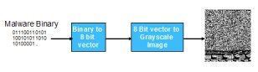
Dataset Description Cont.
Figure 1: Image from [4]. Visualizing malware as a grayscale image.
09
19.08.2023
Vision Based Malware Classification Framework Based on Neural Network

Slide 10
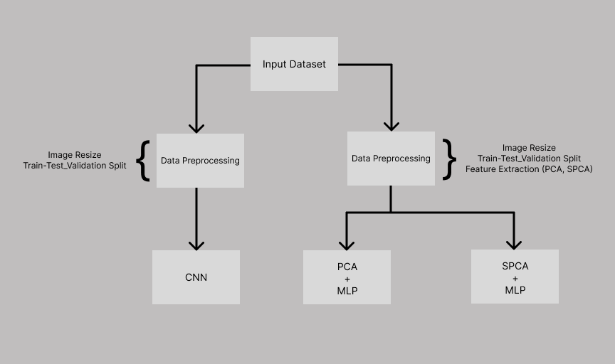
Proposed Method
Figure 2: Workflow of the proposed method
10
19.08.2023
Vision Based Malware Classification Framework Based on Neural Network

Slide 11
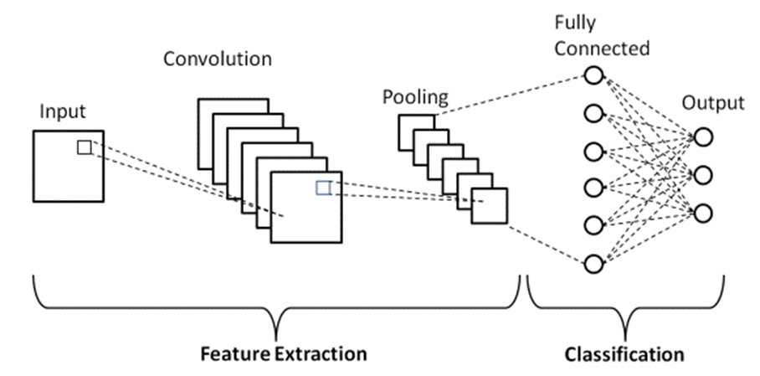
Proposed Method Cont.
Figure 3 : Basic CNN architecture
11
19.08.2023
Vision Based Malware Classification Framework Based on Neural Network

Slide 12
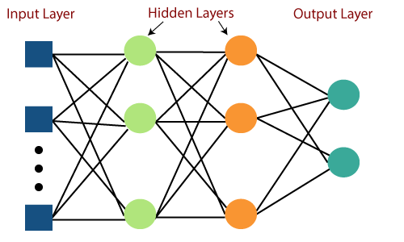
Proposed Method Cont.
Figure 4 : Basic MLP architecture
12
19.08.2023
Vision Based Malware Classification Framework Based on Neural Network

Slide 13
Workflow
01
02
03
Gathering and preprocessing of data
Applying different model architectures
Analyzing the results through performance metrics like Accuracy, Precision, and F1 Score
13
19.08.2023
Vision Based Malware Classification Framework Based on Neural Network

Slide 14
Implementation
Gathered Dataset and done sampling and scaling
Converted malware binaries into grayscale image
Applied CNN for classification
Applied PCA and SPCA for dimensionality reduction
Applied Multi Layer Perceptron for classification
14
19.08.2023
Vision Based Malware Classification Framework Based on Neural Network

Slide 15


Implementation Cont.
Figure 5 : Grayscale images of malware binaries
15
19.08.2023
Vision Based Malware Classification Framework Based on Neural Network

Slide 16
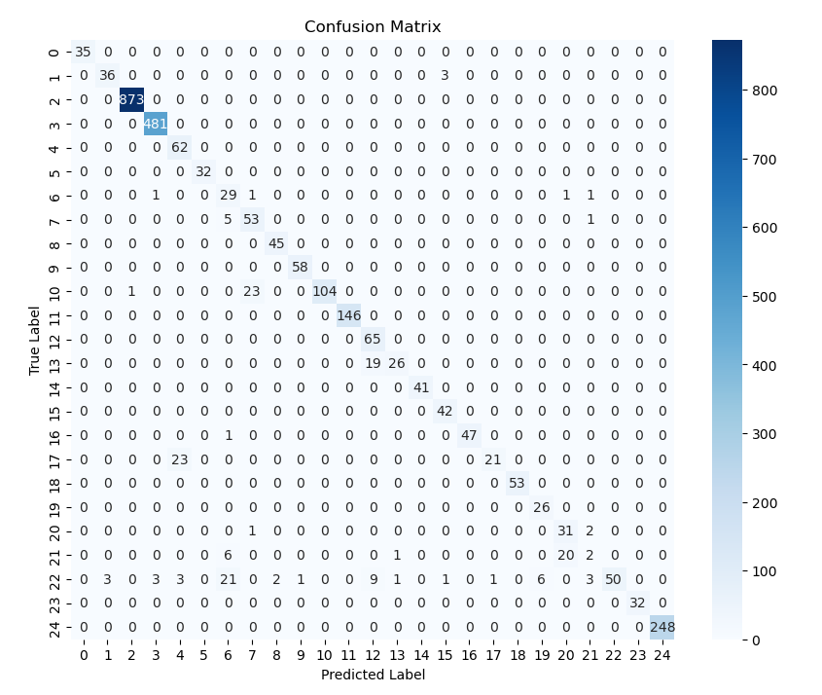
Result Analysis (CNN)
Accuracy : 97.57%
Precision : 95.68%
F1 Score :
95.68%
Figure 6 : Confusion Matrix using CNN model
16
19.08.2023
Vision Based Malware Classification Framework Based on Neural Network

Slide 17
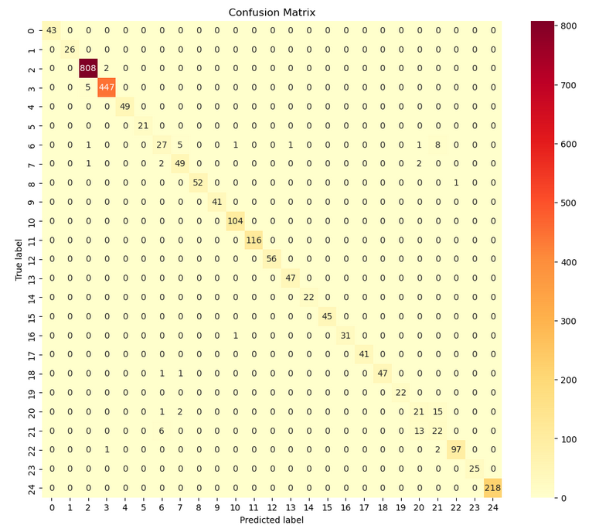
Result Analysis (PCA-MLP)
Components: 30
Accuracy : 97.13%
Precision : 94.23%
F1 Score : 94.00%
Figure 7 : Confusion Matrix using PCA-MLP model
17
19.08.2023
Vision Based Malware Classification Framework Based on Neural Network

Slide 18
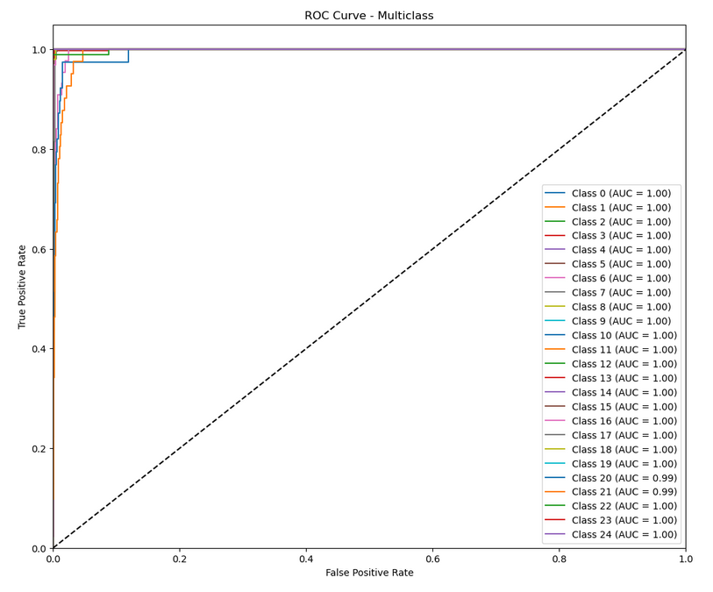
Result Analysis (PCA-MLP)
Components: 30
Accuracy : 97.13%
Precision : 94.23%
F1 Score : 94.00%
Figure 8 : ROC Curve for PCA-MLP model
18
19.08.2023
Vision Based Malware Classification Framework Based on Neural Network

Slide 19
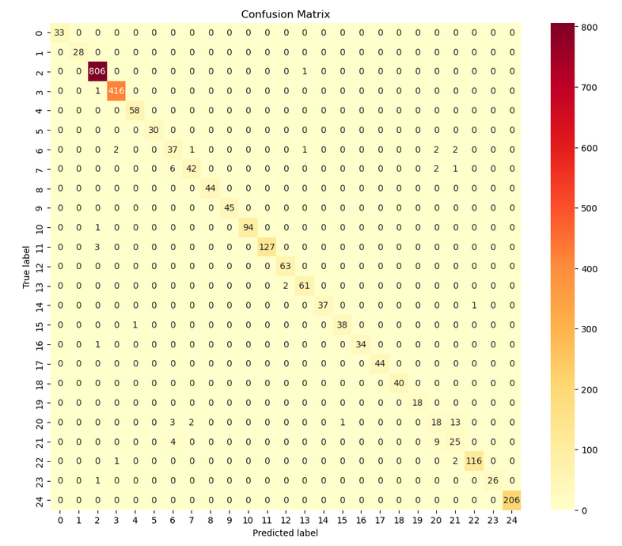
Result Analysis (SPCA-MLP)
Components: 30
Accuracy : 97.49%
Precision : 94.82%
F1 Score : 94.51%
Figure 9 : Confusion Matrix using SPCA-MLP model
19
19.08.2023
Vision Based Malware Classification Framework Based on Neural Network

Slide 20
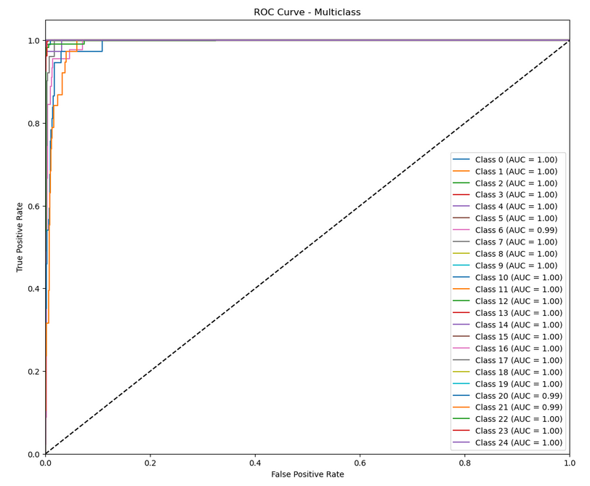
Result Analysis (SPCA-MLP)
Components: 30
Accuracy : 97.49%
Precision : 94.82%
F1 Score : 94.51%
Figure 10 : Confusion Matrix using SPCA-MLP model
20
19.08.2023
Vision Based Malware Classification Framework Based on Neural Network

Slide 21
Model Comparison
Model | Accuracy | Recall | Precision | F1 Score
CNN | 97.57% | 95.68% | 95.68% | 95.68%
PCA-MLP | 97.13% | 94.69% | 94.23% | 94.00%
SPCA-MLP | 97.49% | 95.44% | 94.82% | 94.51%
Table 2: Comparison of the models
21
19.08.2023
Vision Based Malware Classification Framework Based on Neural Network

Slide 22
Future Work
Implement ResNet-152 architecture for feature extraction
Implement other deep learning models
Search for better accuracy and compare the outcomes
22
19.08.2023
Vision Based Malware Classification Framework Based on Neural Network

Slide 23
Conclusion
Vision-based malware detection can detect malware that has been encrypted to avoid detection by traditional methods
1
Vision-based malware detection can be used to detect new and unknown malware that has not yet been categorized or identified by traditional methods
2
Deep learning approach performs better than traditional methods providing better accuracy and efficiency.
3
23
19.08.2023
Vision Based Malware Classification Framework Based on Neural Network

Slide 24
Reference
[1] Nataraj, L., Karthikeyan, S., Jacob, G., Manjunath, B.S.: Malware images: visualization and automatic classification. In: Proceedings of the 8th International Symposium on Visualization for Cyber Security, VizSec ’11, pp. 4:1–4:7. ACM, New York, NY, USA (2011).
[2] Gibert, D., Mateu, C., Planes, J. et al. Using convolutional neural networks for classification of malware represented as images. J Comput Virol Hack Tech 15, 15–28 (2019).
[3] Agarap, A. F. (2017). Towards building an intelligent anti-malware system: a deep learning approach using support vector machine (SVM) for malware classification. ArXiv Preprint ArXiv:1801.00318.
[4] https://www.dropbox.com/s/ep8qjakfwh1rzk4/malimg_dataset.zip?dl=0
24
19.08.2023
Vision Based Malware Classification Framework Based on Neural Network

Slide 25
Thanks!
Do you have any questions?
saadrupai1997@gmail.com
19.08.2023
Vision Based Malware Classification Framework Based on Neural Network

